Slide 1
Hannah Siegel
EE 436 Final Project
Numerical Modeling Report
5/8/2024

Slide 2
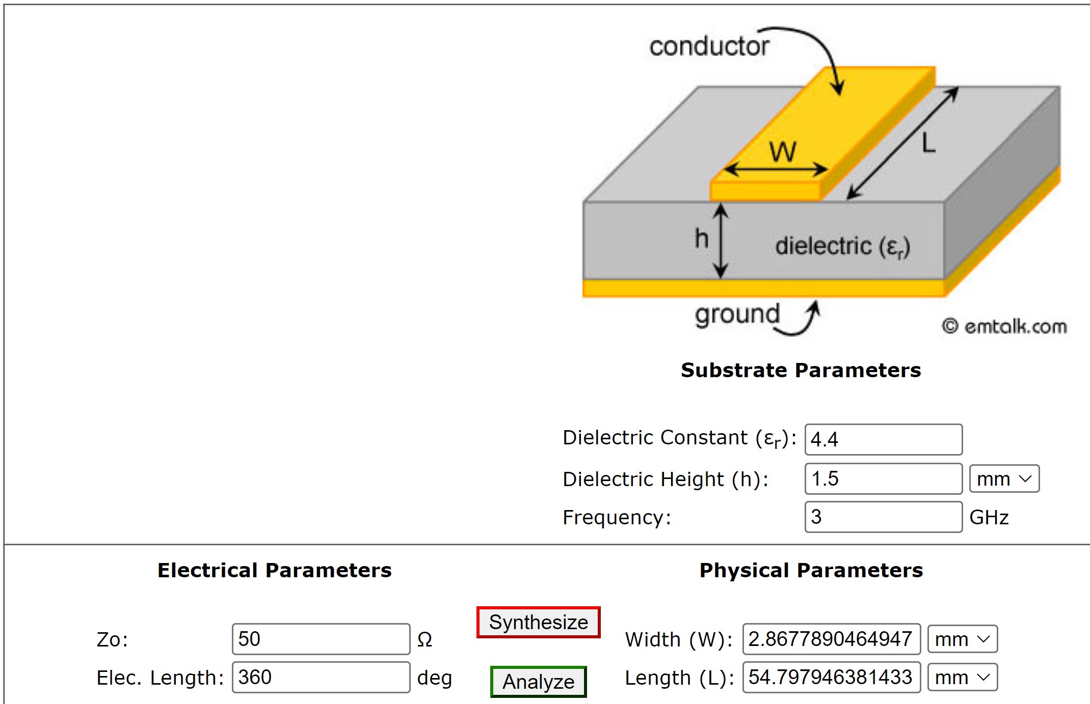
Sonnet: 50 Ω transmission line
em:Talk Screenshot

Slide 3
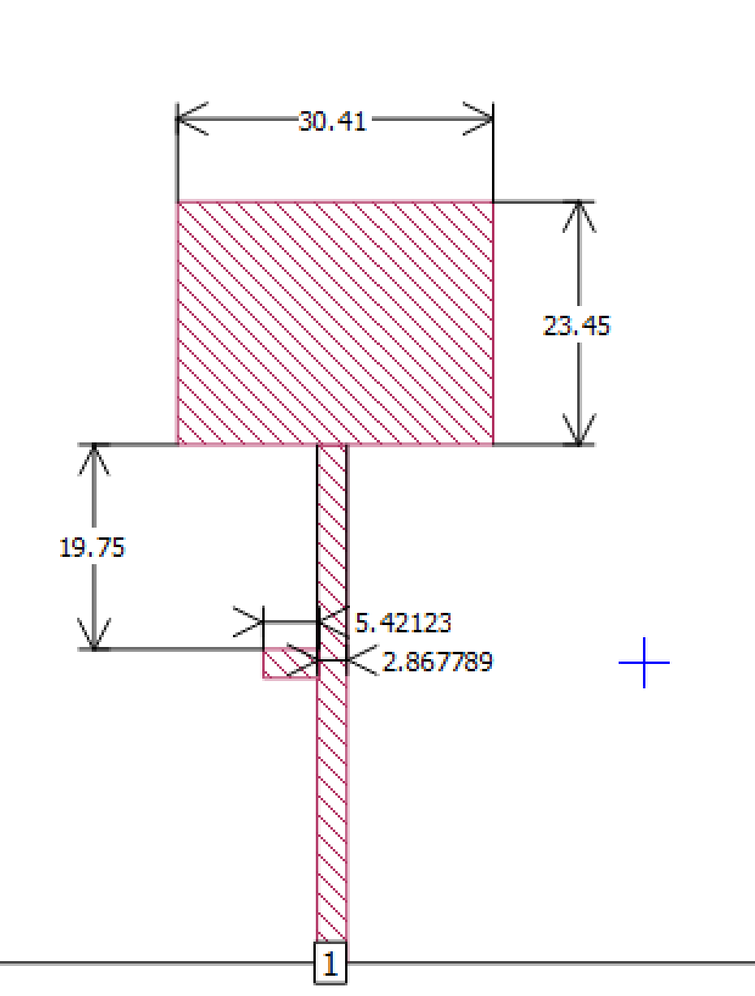
Sonnet: 50 Ω transmission line Insert the simulation geometry

Slide 4
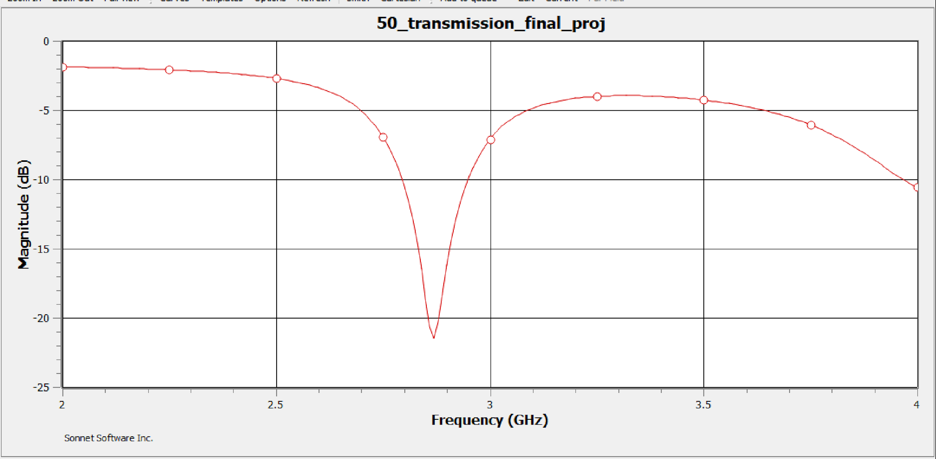
Sonnet: 50 Ω transmission line Insert S11 plot from 2 to 4 GHz

Slide 5
Sonnet: 50 Ω transmission line
a. What are the maximum and minimum reflection coefficients in dB?
b. Does the S11 plot make sense? Explain your answer
Γ_max = -1.875 dB
Γ_min = -21.485 dB
This S11 plot makes sense, as the resonant frequency is approximately 2.87GHz, which is very close to the expected 3GHz.
The measured VWSR was 1.20477 at 2.87GHz, which correlates with the -21.485 dB reflection coefficient.
The minimum reflection coefficient is less than -10dB, which is to be expected.

Slide 6
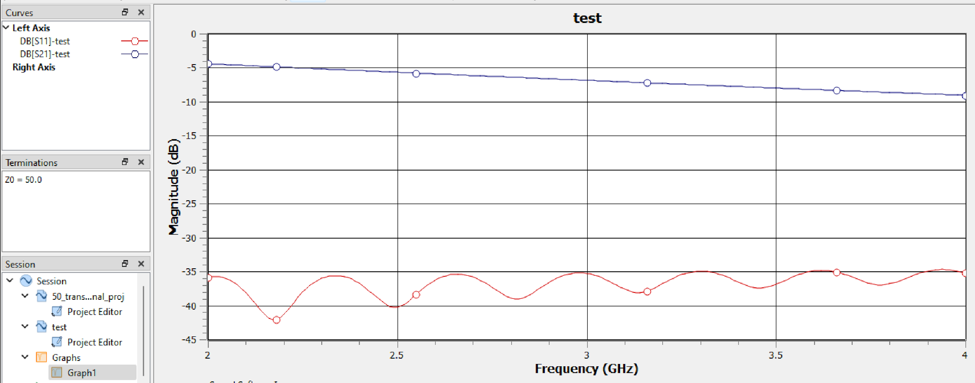
Sonnet: 50 Ω transmission line Plot S21 in the range of 2 – 4 GHz

Slide 7
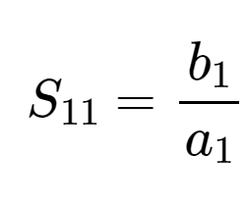
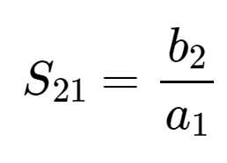
Sonnet: 50 Ω transmission line
a. What are the maximum and minimum transmission coefficients in dB?
b. Does the S21 plot make sense? Explain your answer.
Γ_max = -5.24 dB
Γ_min = -9.82 dB
The S21 plot does make sense, because it is consistent with the expected relationship between S11 and S21 in a 50 Ω transmission line.

Slide 8
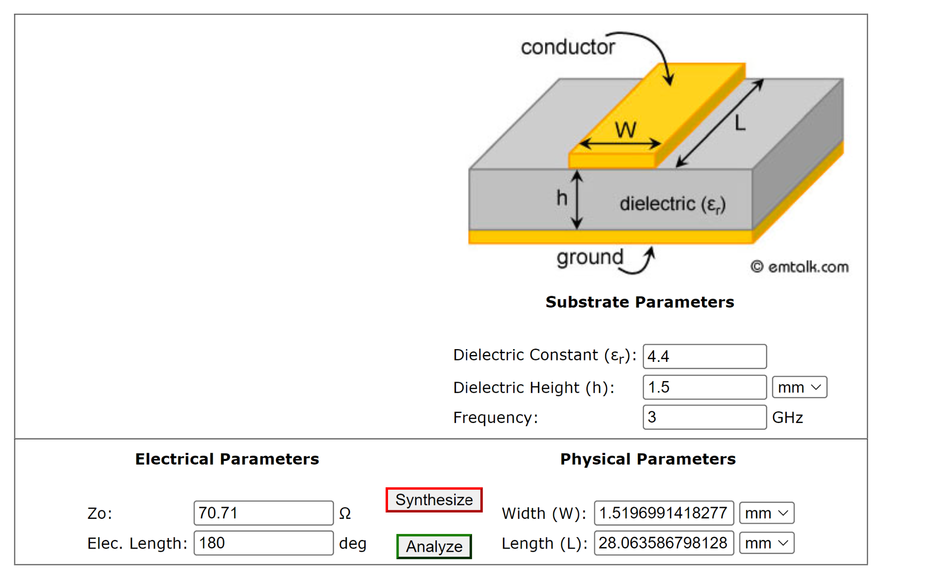
Sonnet: Wilkinson power divider
What is the physical length of the quarter wavelength transformer section?
Show a screenshot of the em:Talk showing the physical length.
𝛌 = (3x10e8) / (3GHz)
𝒍 = 𝛌/4 = 100mm/4 = 25mm
These calculations are different from the actual values used in the implementation of the power divider. This is because the power divider performed better with the adjust values used.

Slide 9
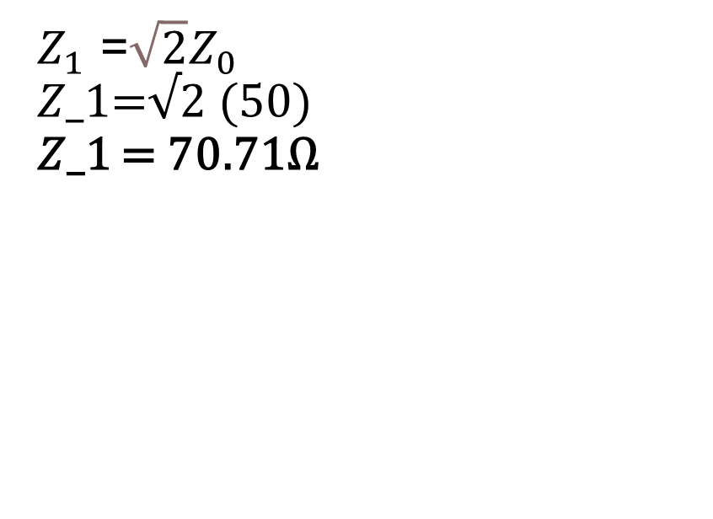
Sonnet: Wilkinson power divider
5. Show the calculation obtaining the impedance of the 3 GHz quarter wavelength transformer section.
$Z_{1}$ =$\sqrt{2}Z_{0}$
𝑍_1=√2 (50)
𝑍_1 = 70.71Ω

Slide 10
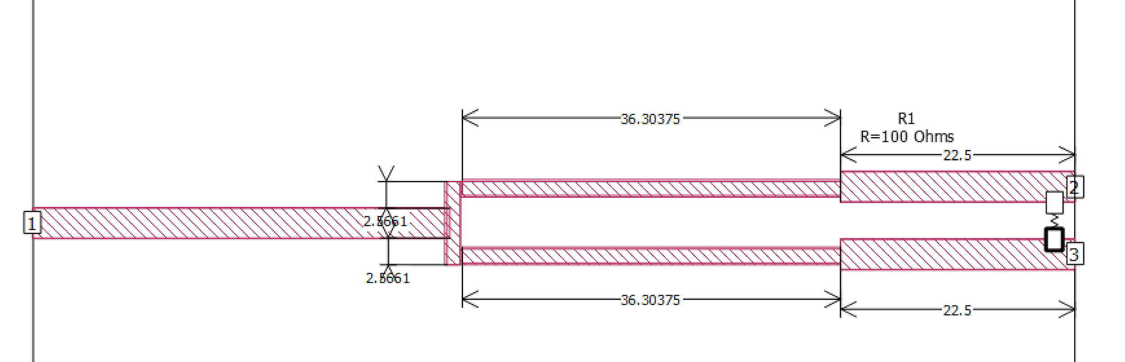
Sonnet: Wilkinson power divider Insert the simulation geometry

Slide 11
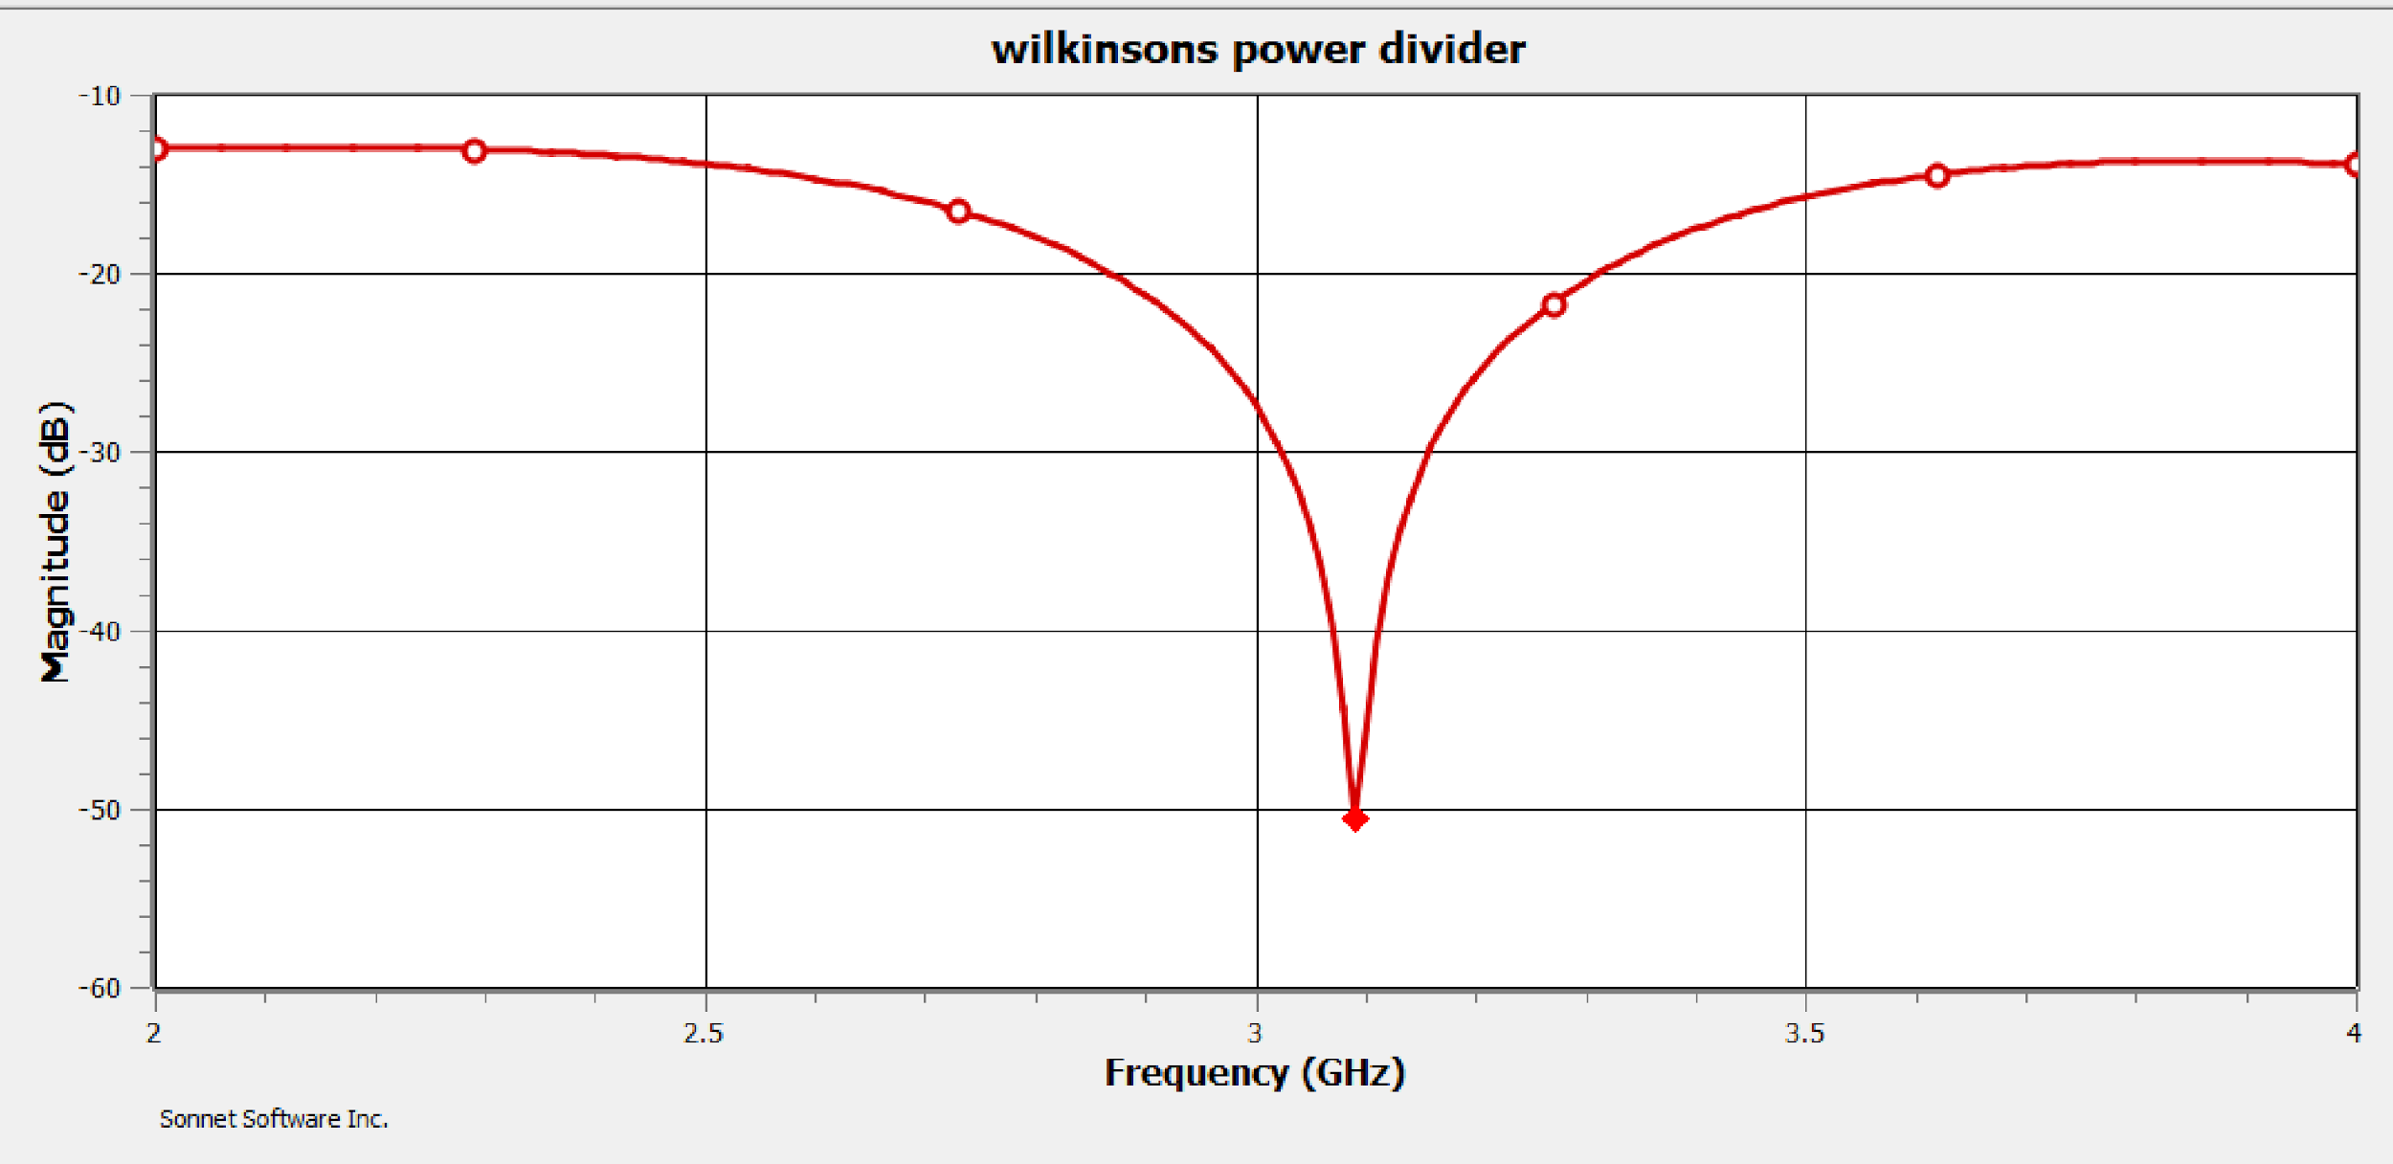
Sonnet: Wilkinson power divider Insert S11 plot in the range of 2 – 4 GHz

Slide 12
Sonnet: Wilkinson power divider
a. What are the maximum and minimum reflection coefficients in dB scale?
b. Does the S11 plot make sense? Explain your answer.
Γ_max = -13.47 dB
Γ_min = -50.63 dB
This S11 plot makes sense because the resonant frequency is 3.09 GHz, which is very close to the desired 3 GHz.
The expected return loss for a Wilkinson’s power divider operating at a resonant frequency below 6 GHz about 20 dB, which fits the return loss of about 50dB from the power divider designed.

Slide 13
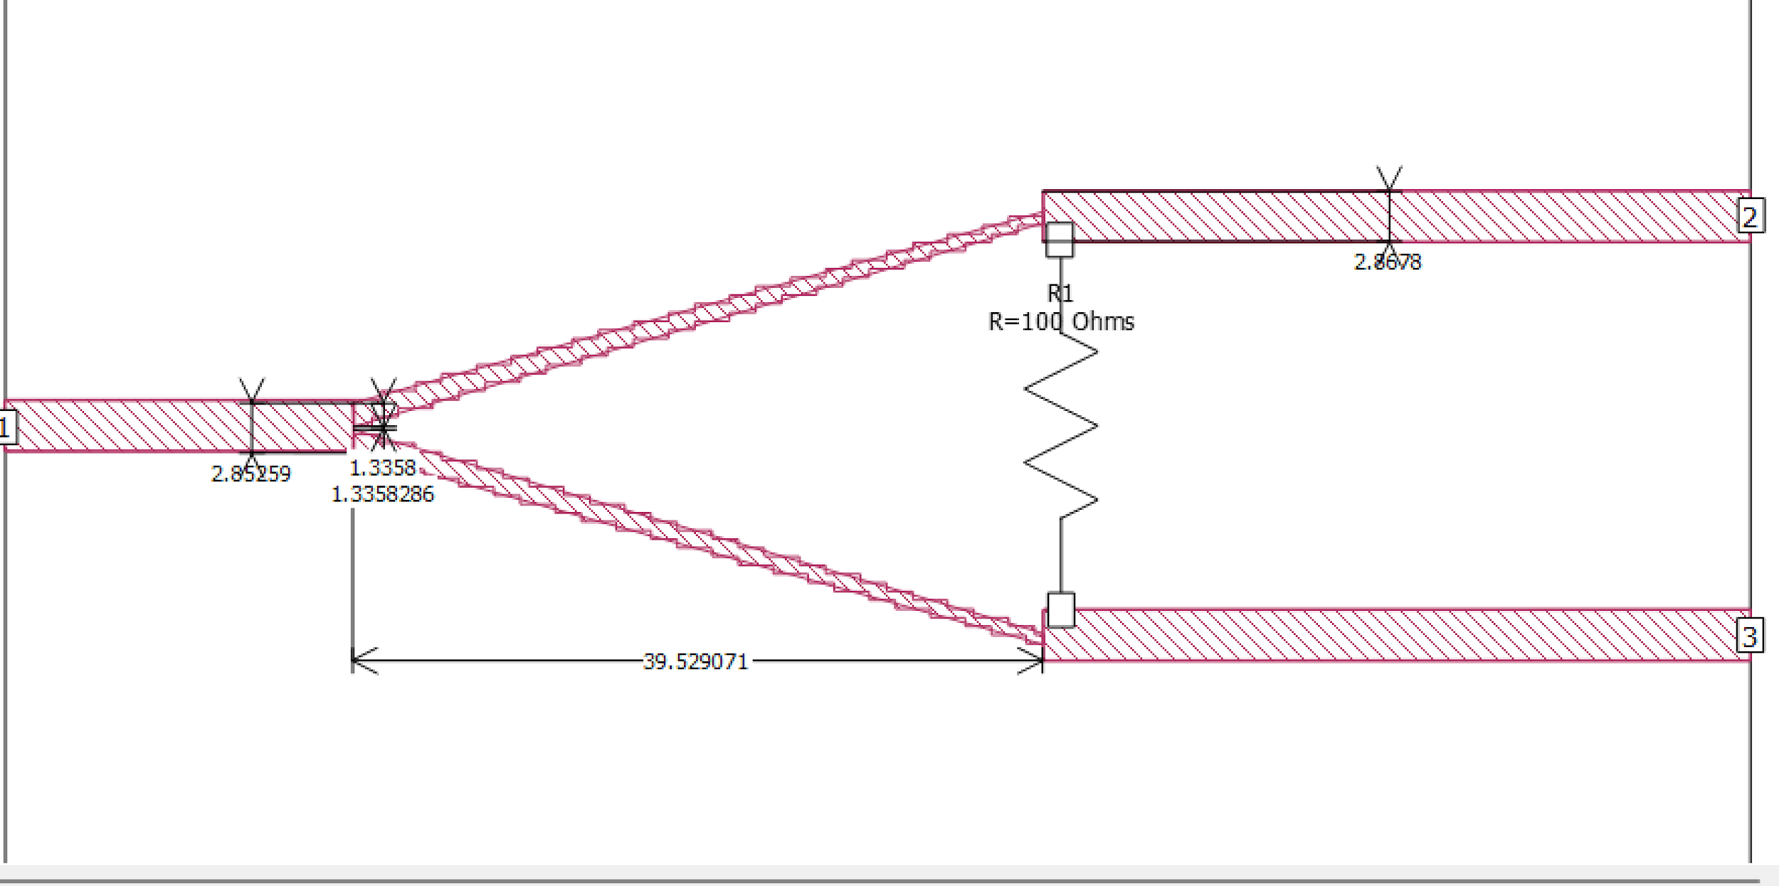
Sonnet: Wilkinson power divider Insert the simulation geometry

Slide 14
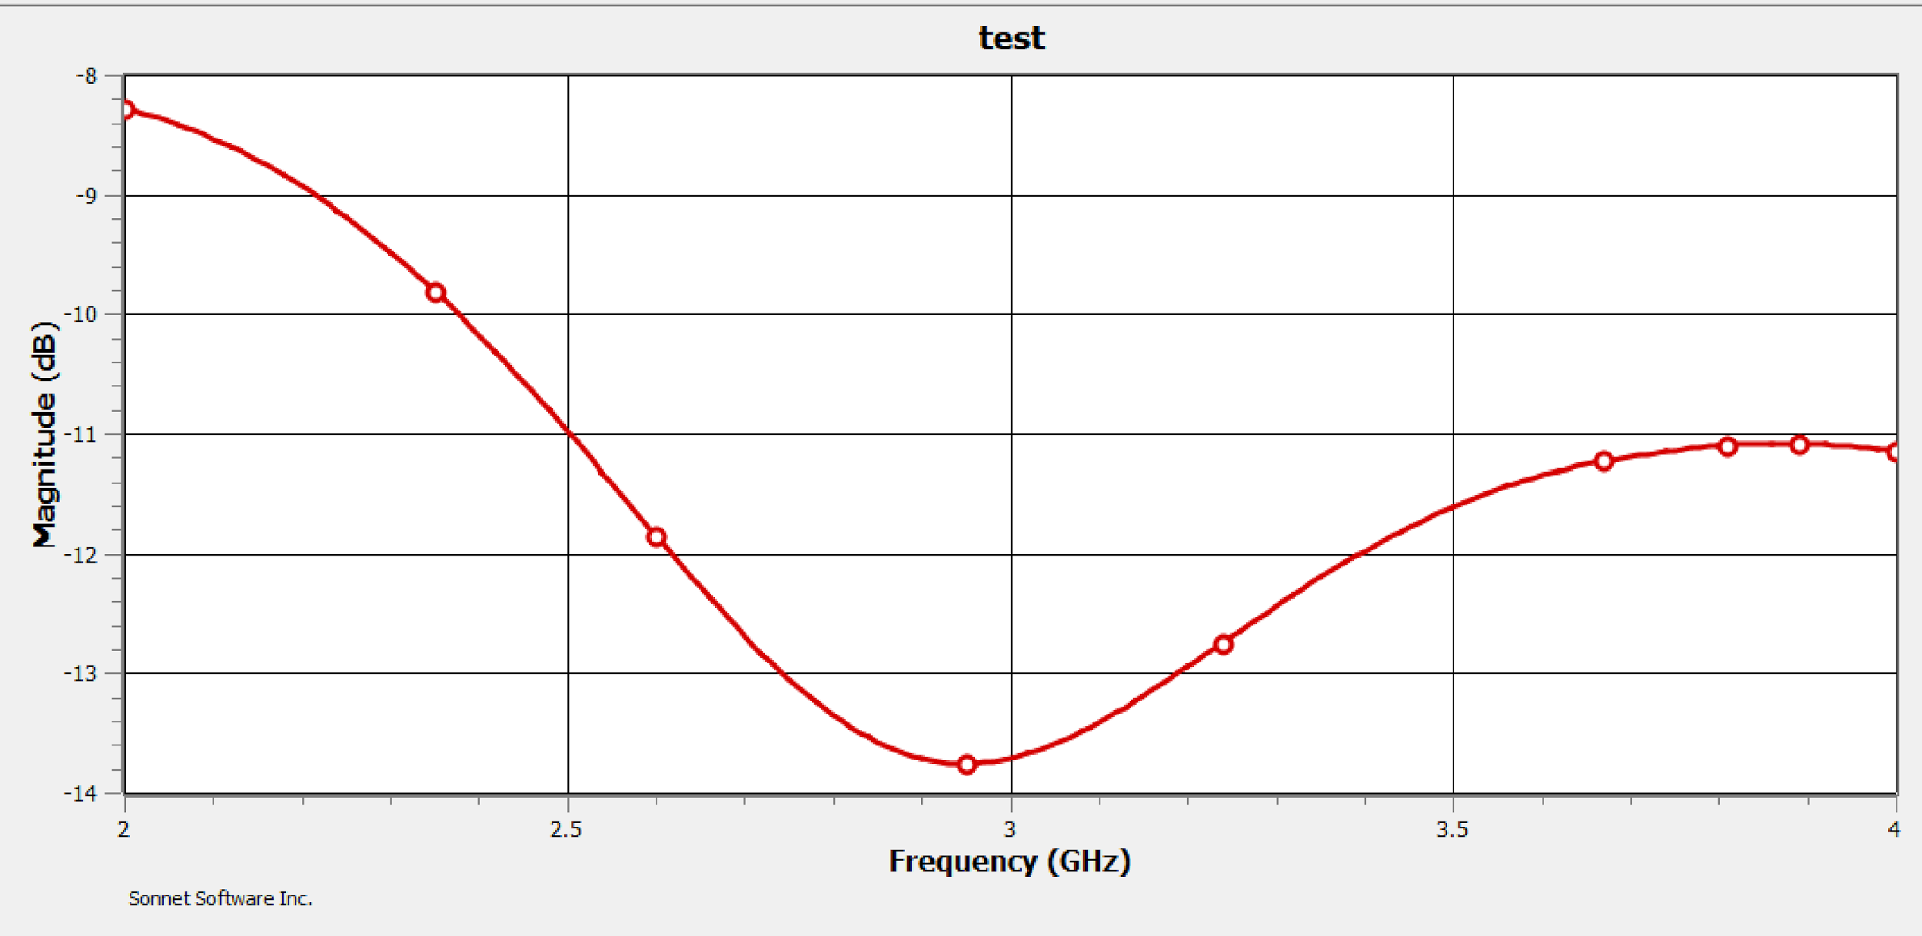
Sonnet: Wilkinson power divider . Insert S11 plot in the range of 2 – 4 GHz

Slide 15
Wilkinson Power Divider Design Justification
The previous Wilkinson Power Divider follows the expected design as covered in class and in previous class activities.
The issue with this design is that it resulted in a significant amount of errors when interacting with ports and the resistor. These issues seemed to persist without any solution and when the design did compile successfully, the results were suboptimal.
These issues are what compelled me to choose an alternative design for the power divider. This design produces the same result and behavior because the bar from which the two arms branch is symmetrical and therefore acts in the same way as if the arms had been positioned in a diagonal formation.
To physically implement this design, it would be recommended to make a triangular notch in the center of the bar, as it has been shown in other cases to improve the performance of this type of alternative design.

Slide 16
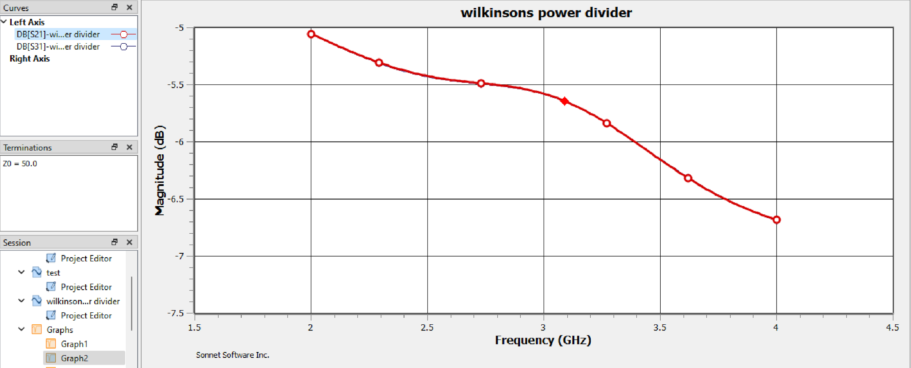
Plot S21 and S31 (two plots superimpose) in the range of 2 – 4 GHz note: both lines are exactly the same so only one is visible

Slide 17
Sonnet: Wilkinson power divider
a. What is the anticipated transmission coefficient?
b. What are the simulated maximum and minimum transmission coefficients in dB?
The anticipated transmission coefficient is around -7dB. This value was reached by using the reflection coefficient to calculate the projected transmission coefficient.
T_max = -5.06 dB
T_min = -6.78 dB

Slide 18
Sonnet: Wilkinson power divider c. Do these values make sense? Explain your answer.
These values do make sense as the overlapping of S21 and S31 indicates that there is an equal power division to both ports, which is expected due to the power divider being symmetric.
These results validate that S21 = S31

Slide 19

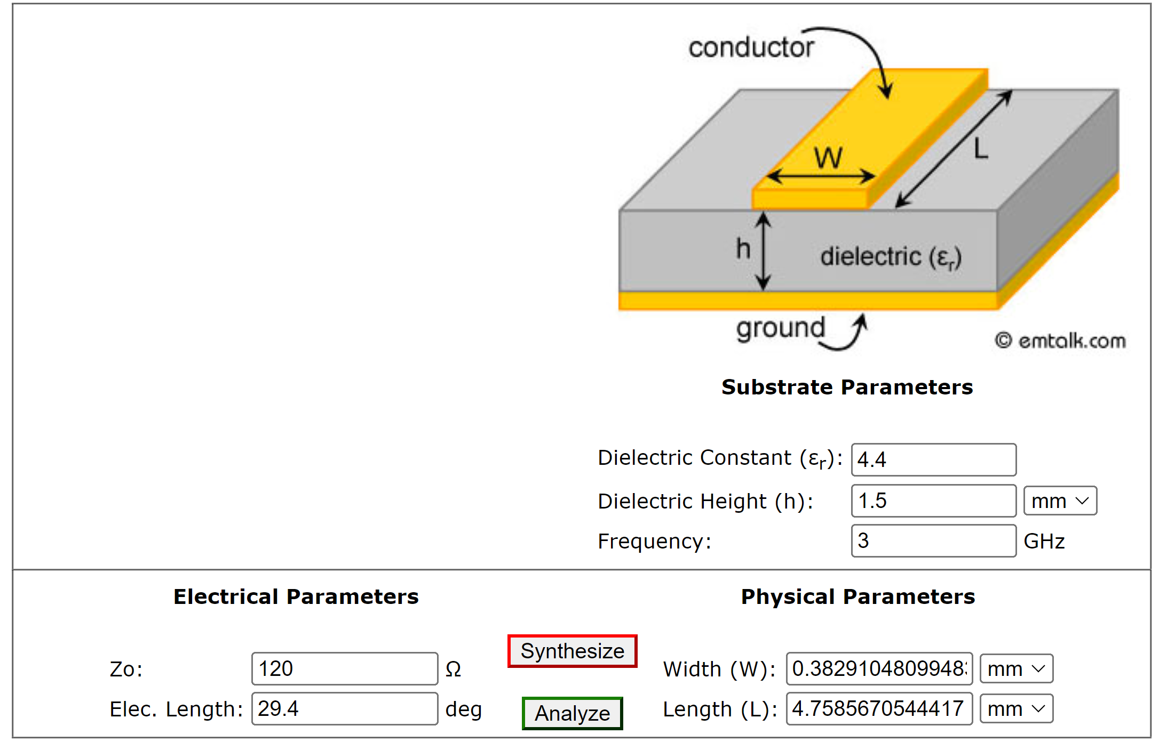
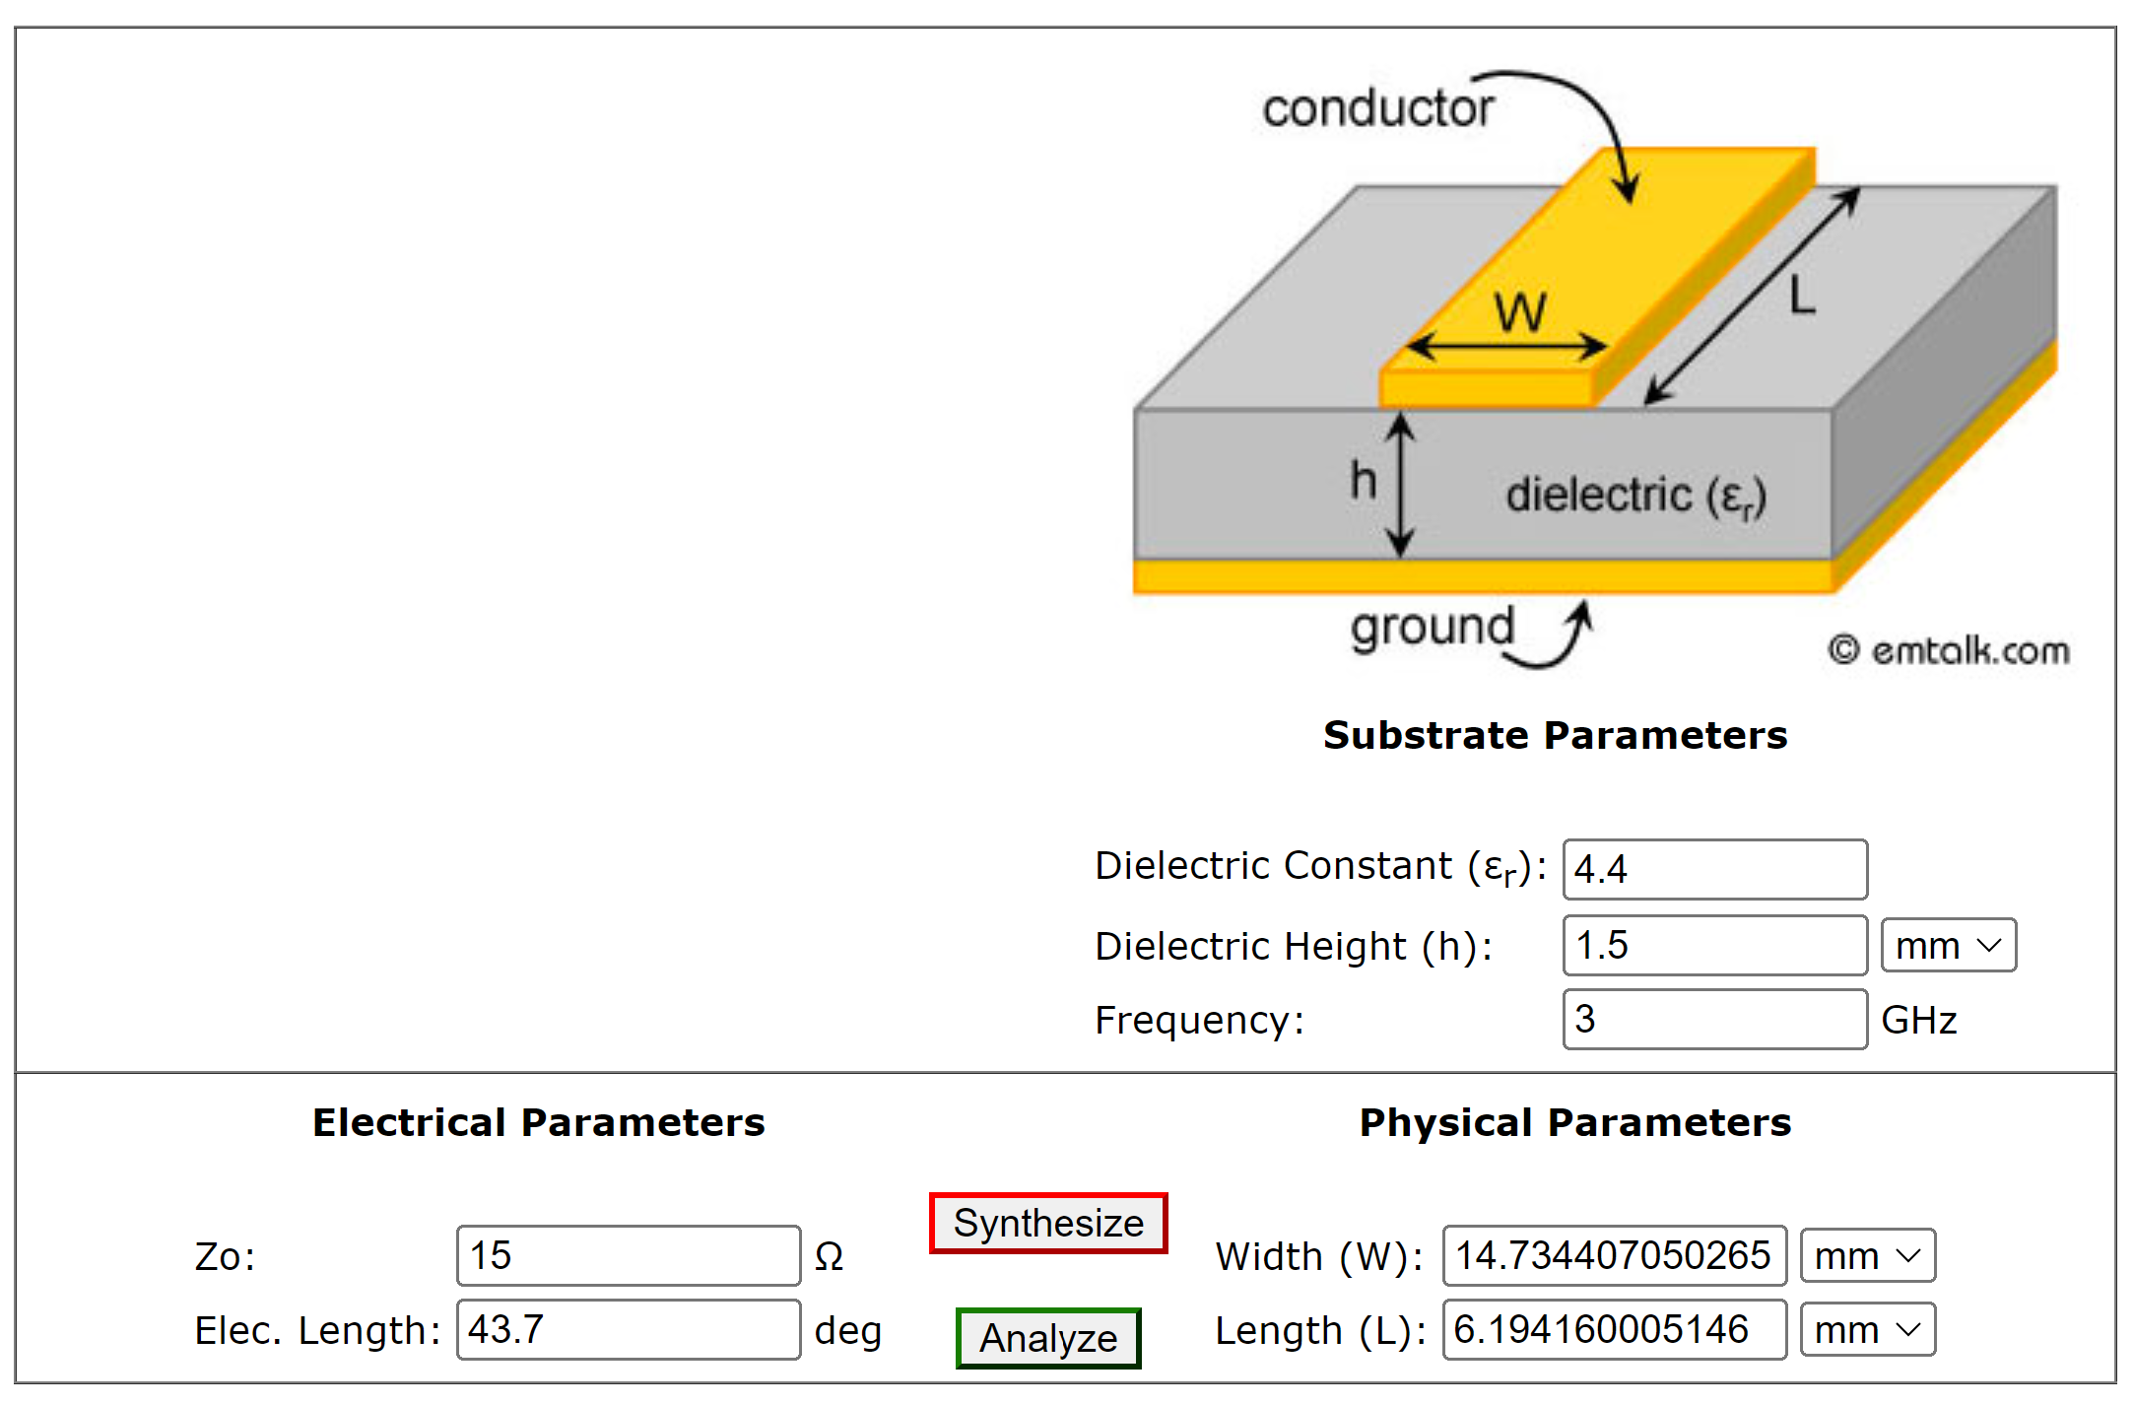
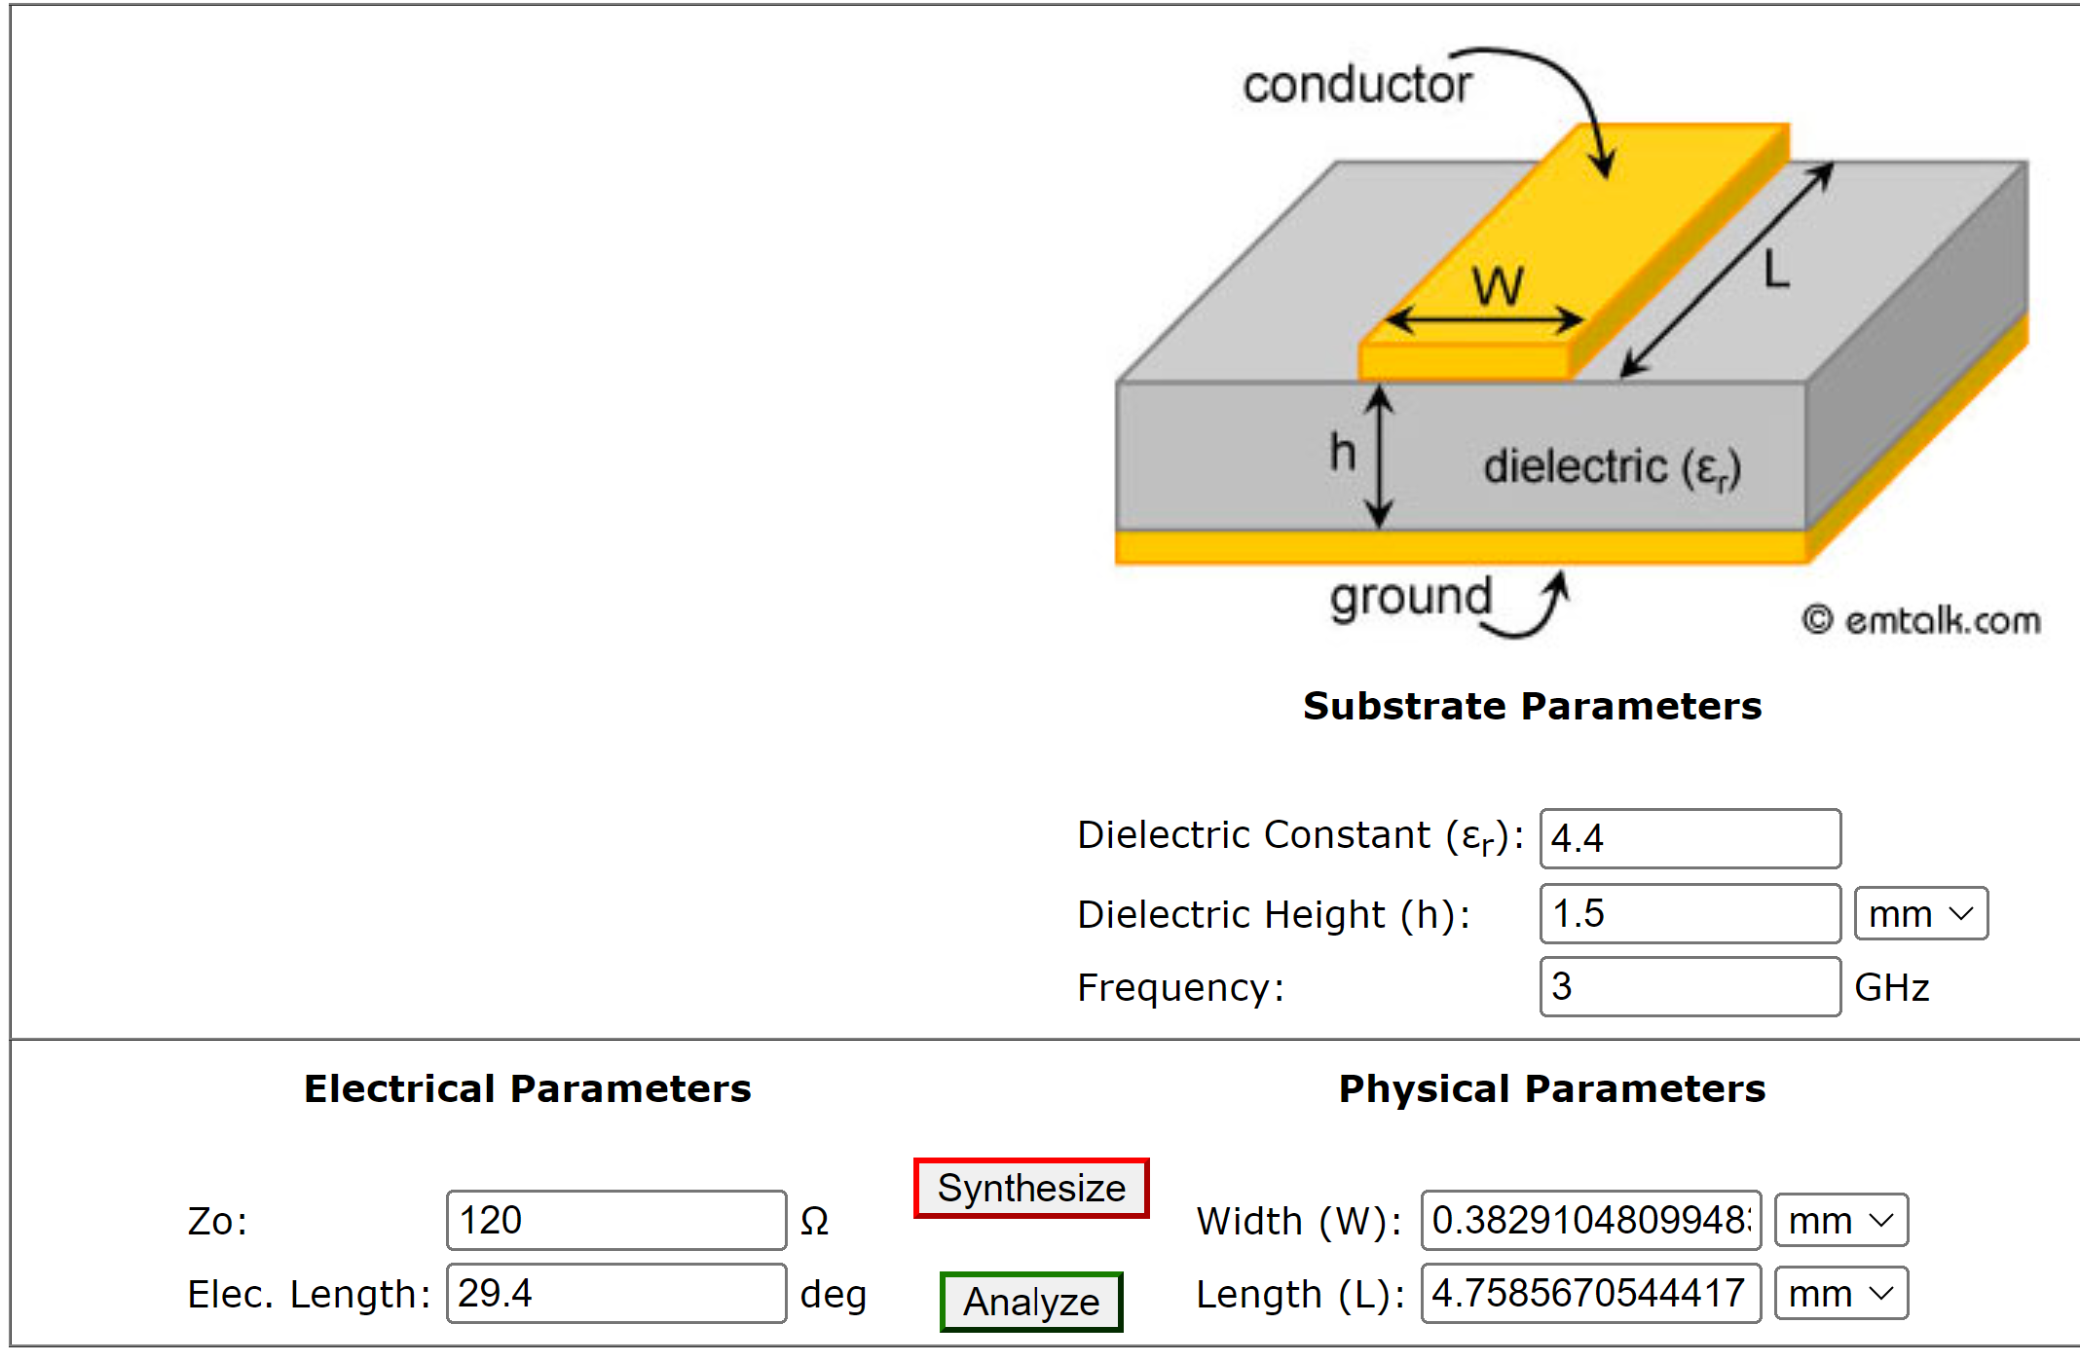
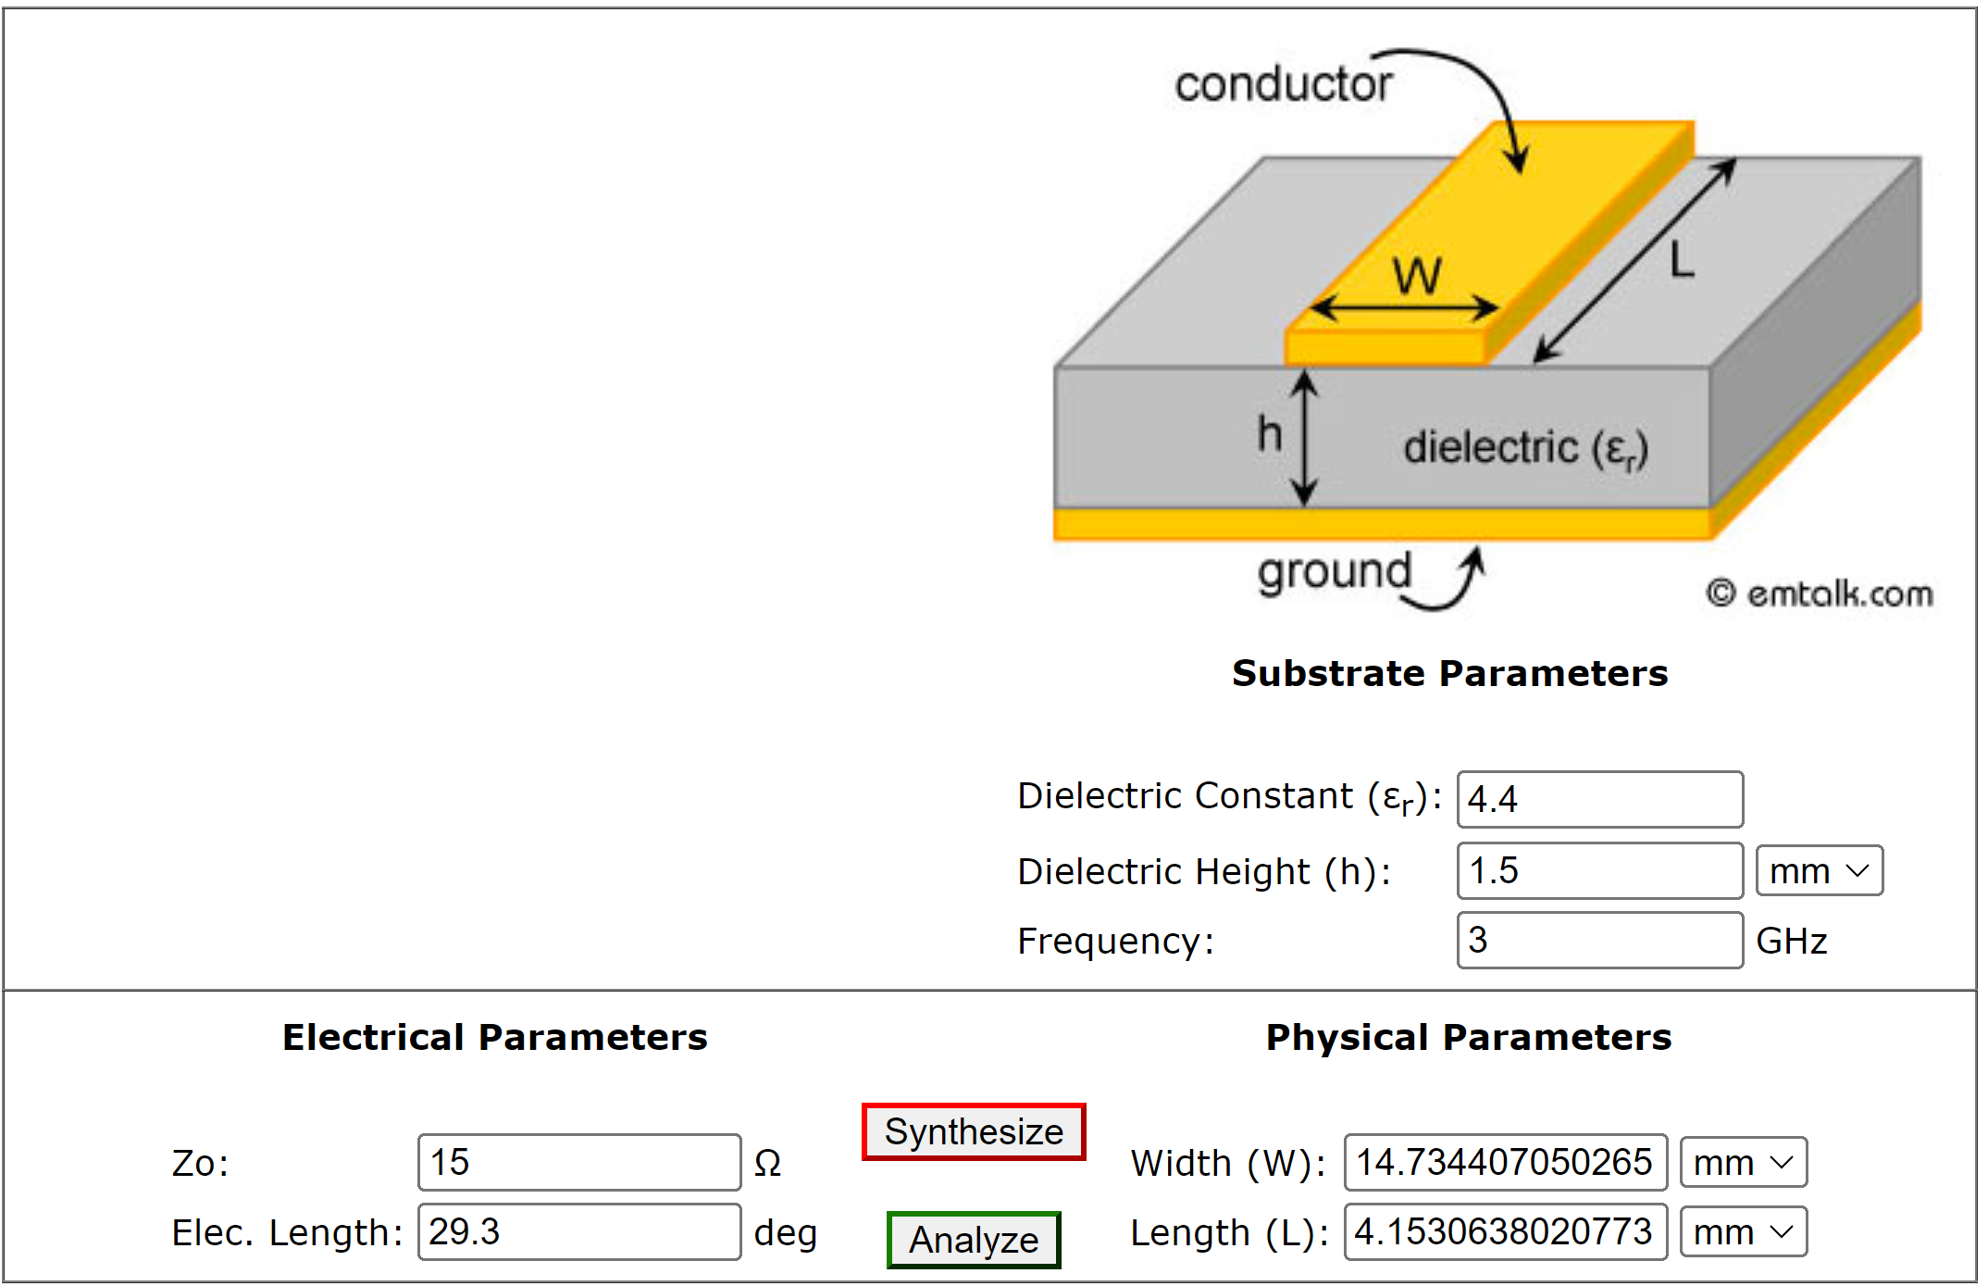
Sonnet: Stepped impedance low-pass filter
C1
L2
C3
C4
L5

Slide 20
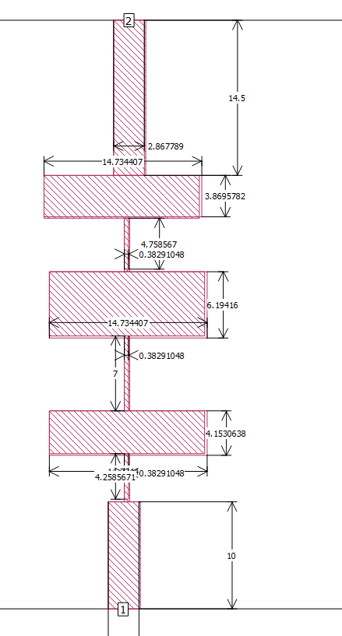
Sonnet: Stepped impedance low-pass filter Insert the simulation geometry

Slide 21
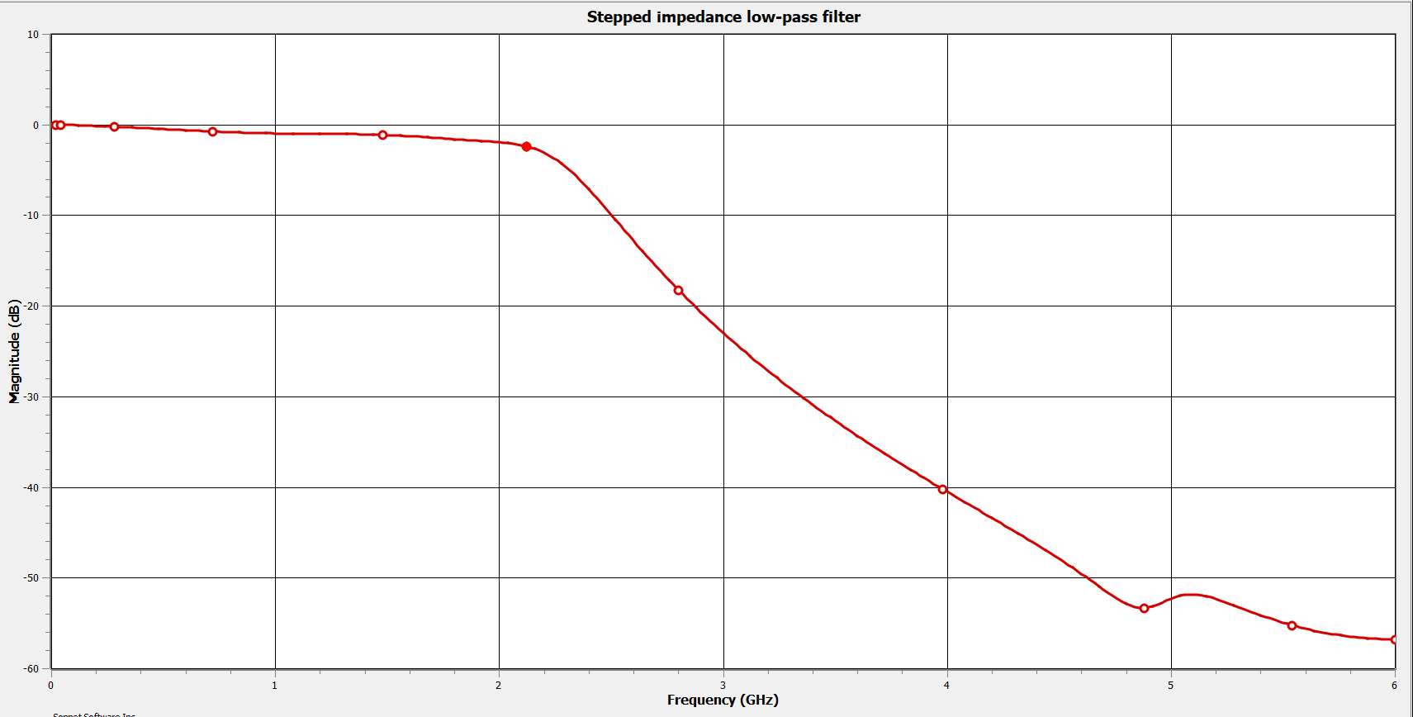
Insert dB(S21) plot from 0 to 6 GHz and mark the cut-off frequency (- 3dB point) on the plot

Slide 22
Insert dB(S21) plot from 0 to 6 GHz and mark the cut-off frequency (- 3dB point) on the plot
a. What is the cut-off frequency?
b. Does this meet your design specifications?
The cut-off frequency measured at -3 dB point is 2.54 GHz.
This does meet the design specifications for the filter.
The cut-off frequency for the filter per the design specifications was 3 GHz, but the actual cut off frequency was 2.54 GHz. This is not a number that is unreasonable, but it is a significant enough discrepancy to be notes.

Slide 23
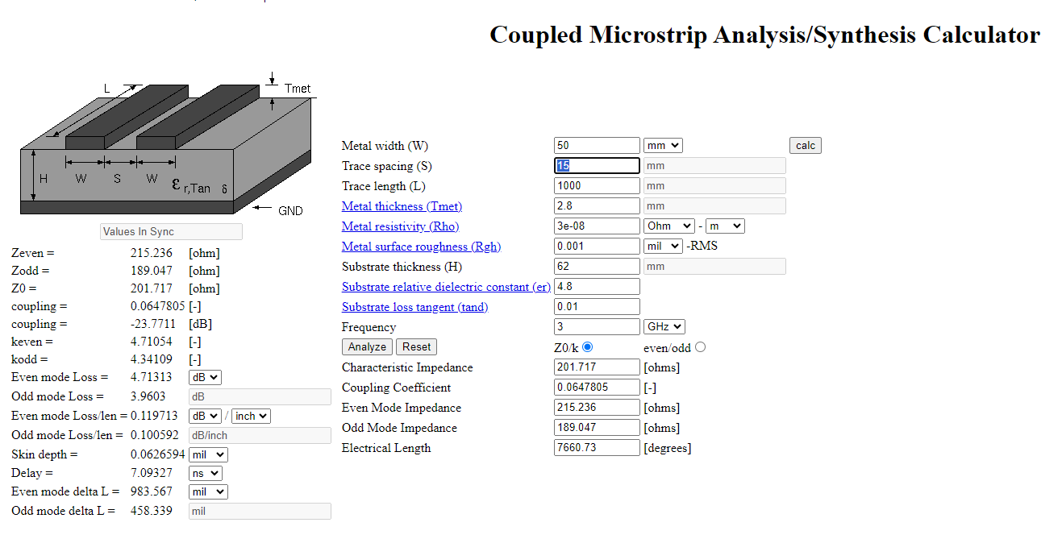
Microstrip Line Coupler

Slide 24
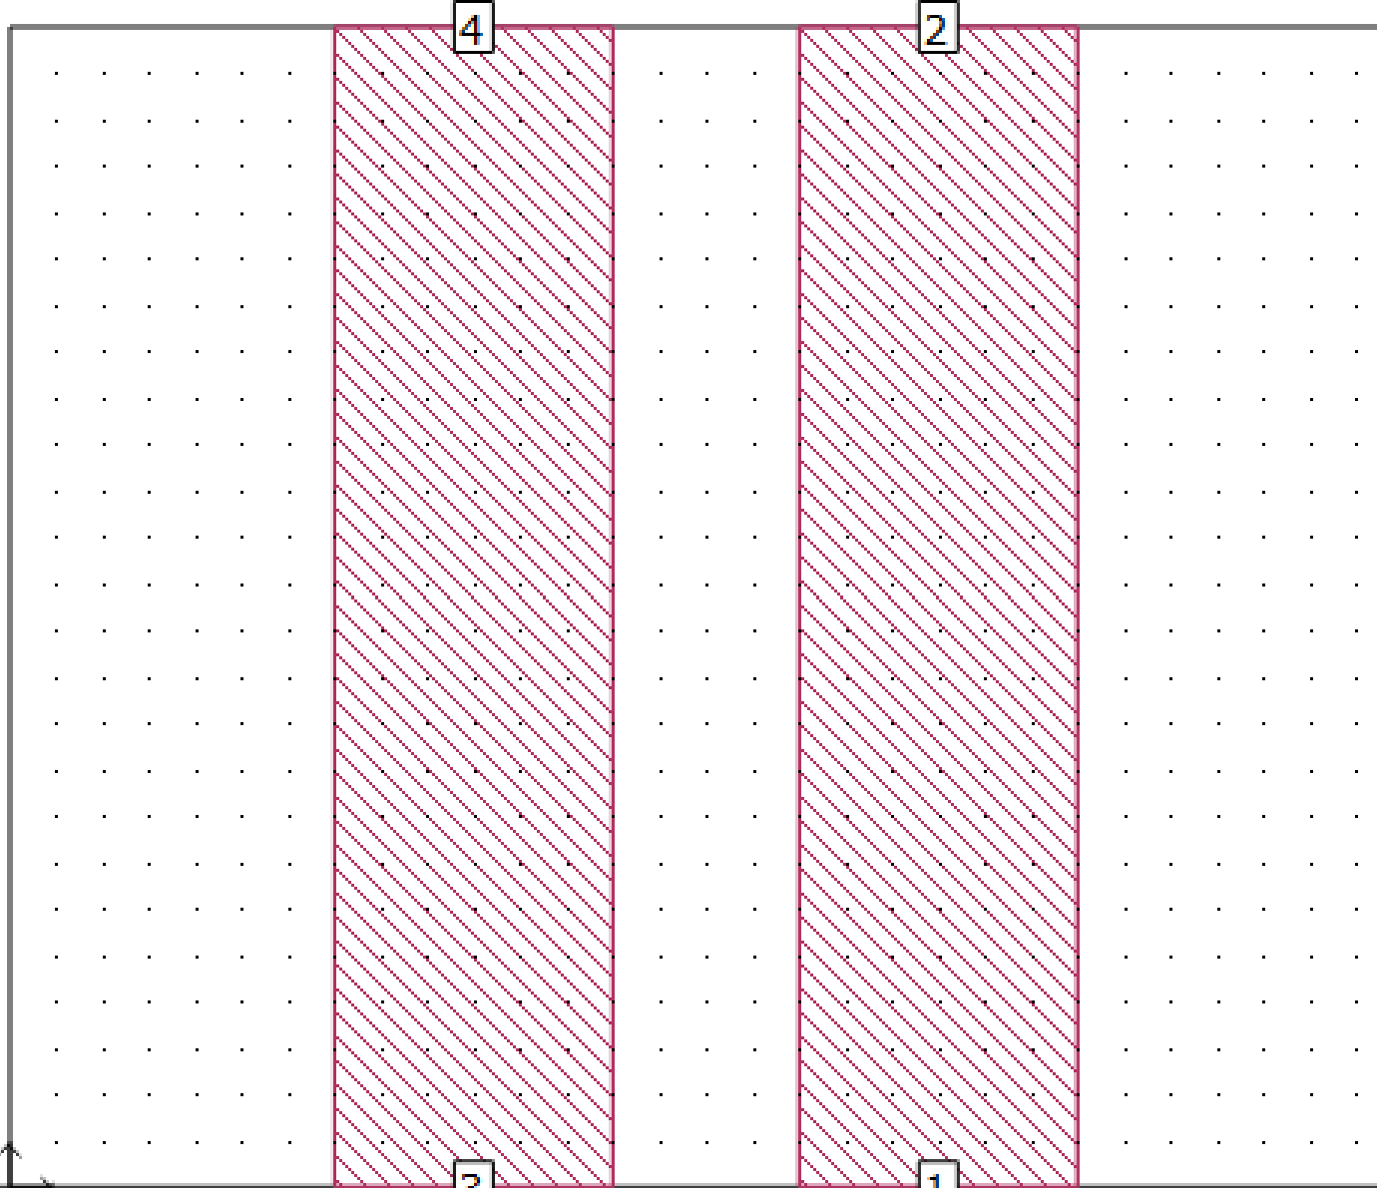
Microstrip Line Coupler insert geometry

Slide 25
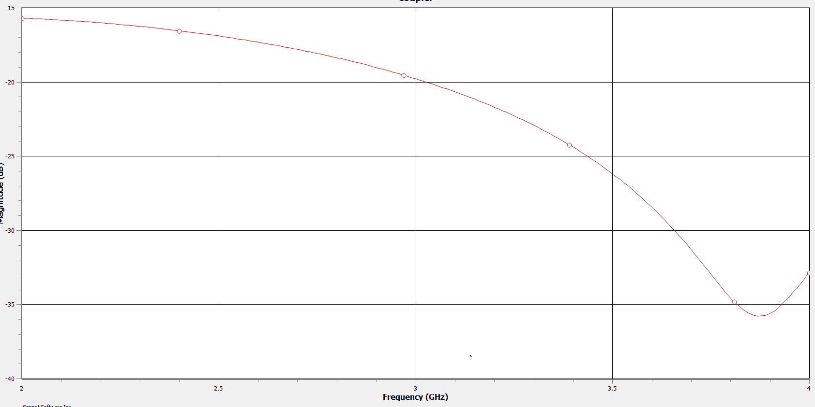
S11

Slide 26
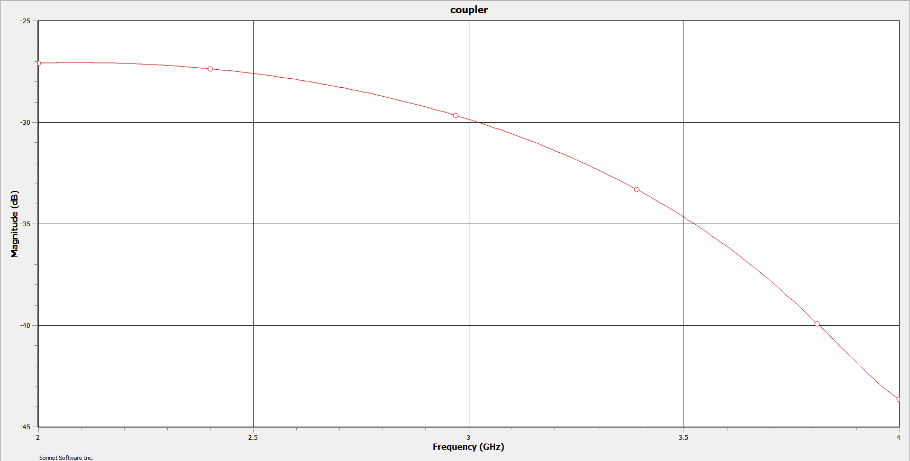
S31

Slide 27
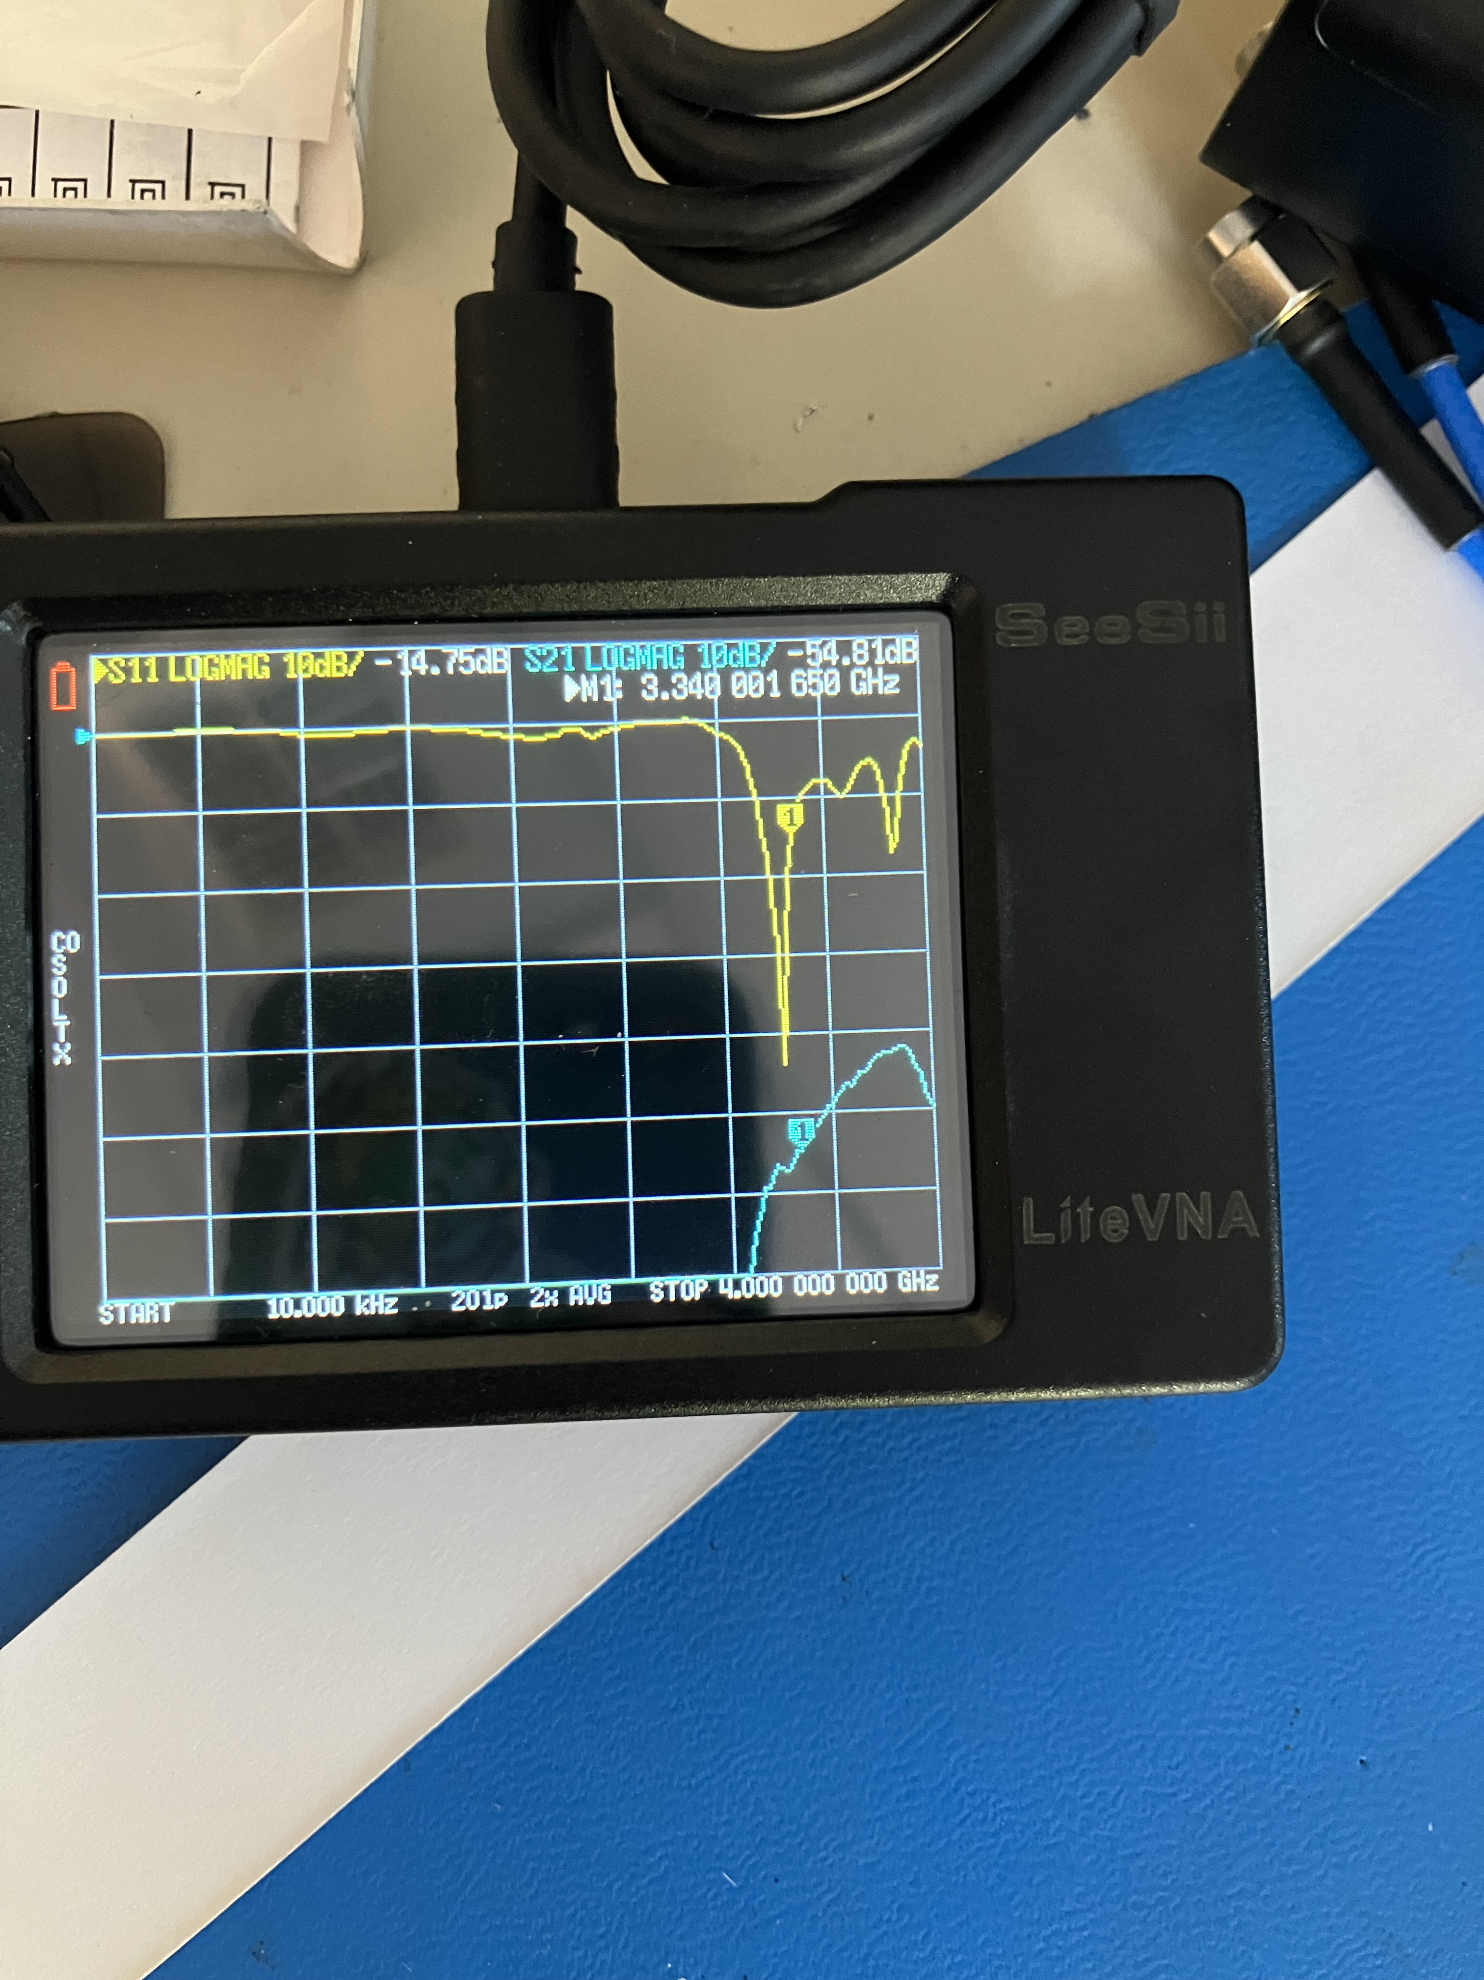
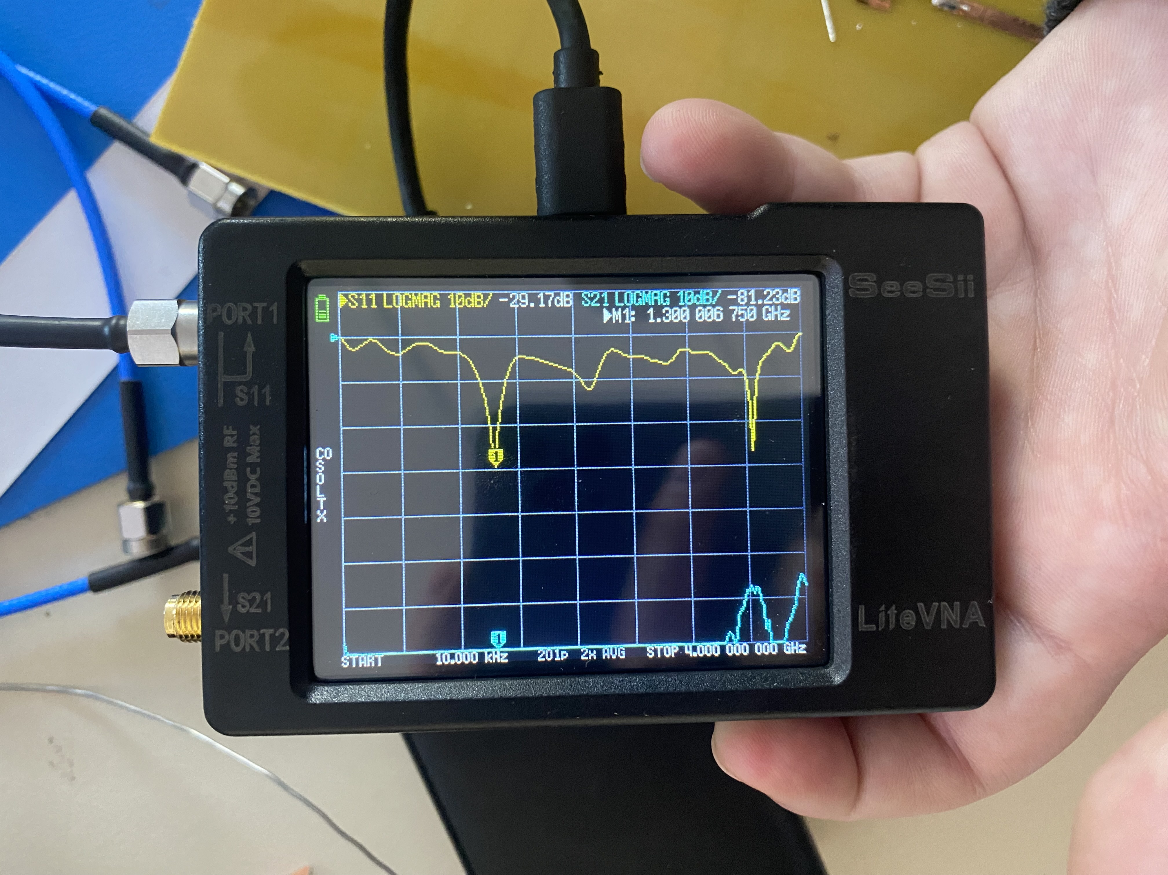
Fabrication Report Insert photos of the measured S11 of the TX and RX antennas

Slide 28
a. What are the operating frequencies?
The operating frequencies of both Rx and Tx are both approximately 3.1 GHZ.
The operating frequency is harder to view for Rx as there are two distinct dips indicating an operating frequency. But it is the second low point which indicates an operating frequency of about 3.07 GHz, which is close to the 3.1 GHz of Tx.

Slide 29
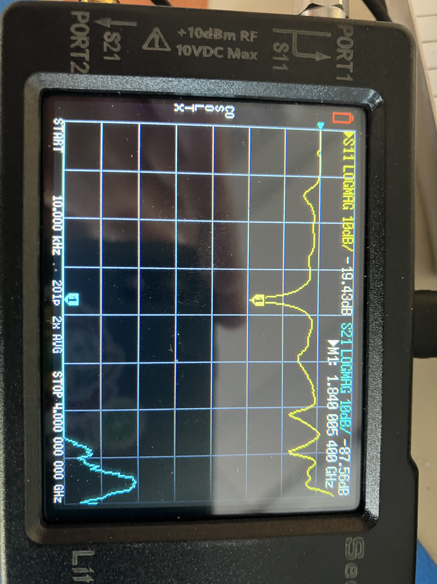
Insert a photo of the measured S31 of the Wilkinson power divider.

Slide 30
Insert a photo of the measured S31 of the Wilkinson power divider. a. What is the S21 at 3 GHz, and is this the anticipated value?
For a Wilkinson power divider S21 = S31.
S21 at 3 GHz is about -8dB, which is lower than what was anticipated in the Sonnet simulations. This discrepancy can be attributed to the construction of the power divider with the copper tape. With the small size and inaccurate nature of hand cutting and placing component, there is an expected amount of error.

Slide 31
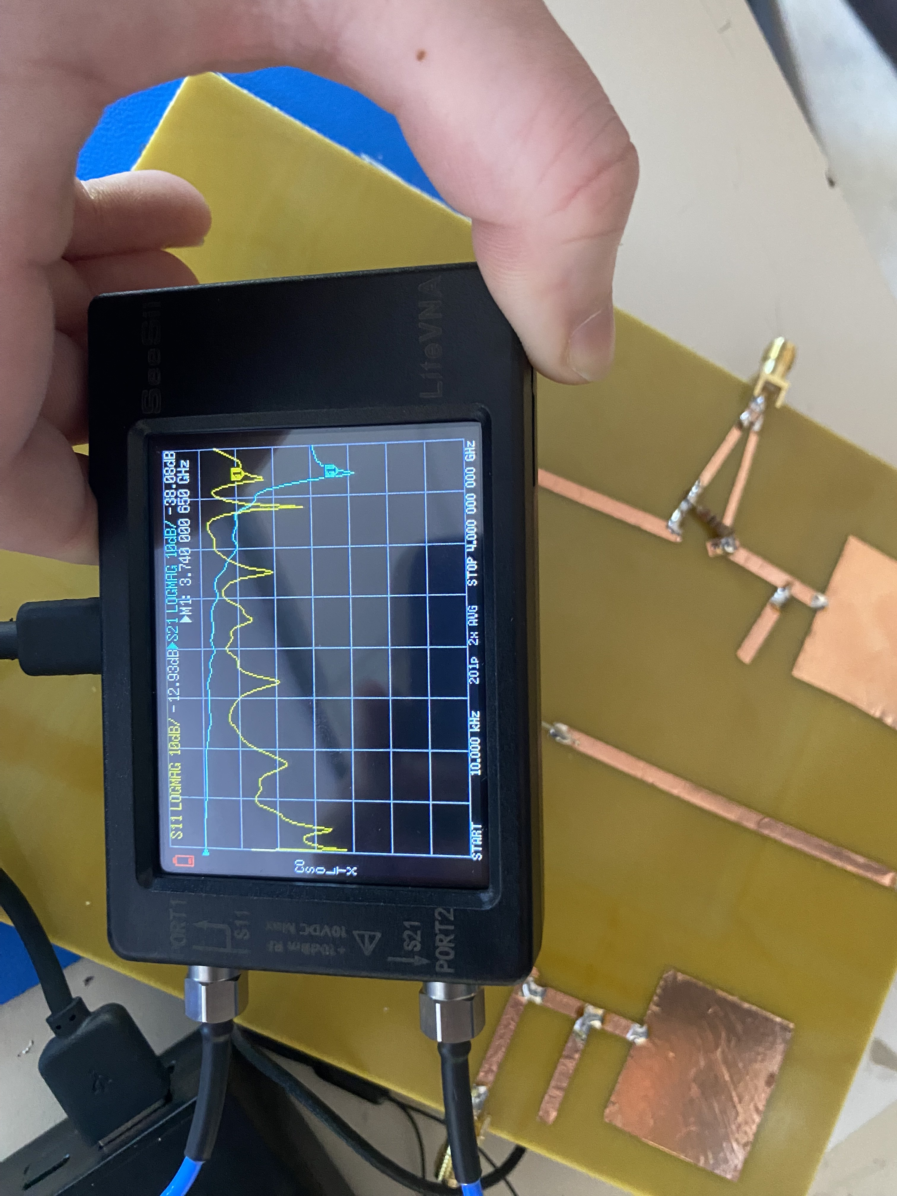
Insert measured S21 of the low-pass filter

Slide 32
Insert measured S21 of the low-pass filter a. What is the cut-off frequency, and is this anticipated value?
The cut off frequency is
This is not the anticipated value. A justification for this discrepancy is that when soldering and constructing the filter, errors in handling such small pieces of copper tape could have potentially cause a short circuit or bypass of the filter.

Slide 33
Connect a signal generator and oscilloscope, and measure port 4 of the system while waving your hands over the antennas. Insert a screenshot of the oscilloscope output.
Describe your observations. Do you see a Doppler frequency?
Yes, a doppler frequency was seen when a hand was waved over the antennas.
There was a significant amount of noise which appeared on the oscilloscope during operation. This noise is explained by some sort of grounding issue with the radar system. This conclusion was reached because when a foot was placed on the floor to provide a ground the noise was significantly reduced. The exact origin of the noise isn’t clear, but one justification is that there was some sort of gap or error in the application of solder on the bottom of the FR-4 substrate board.

Slide 34
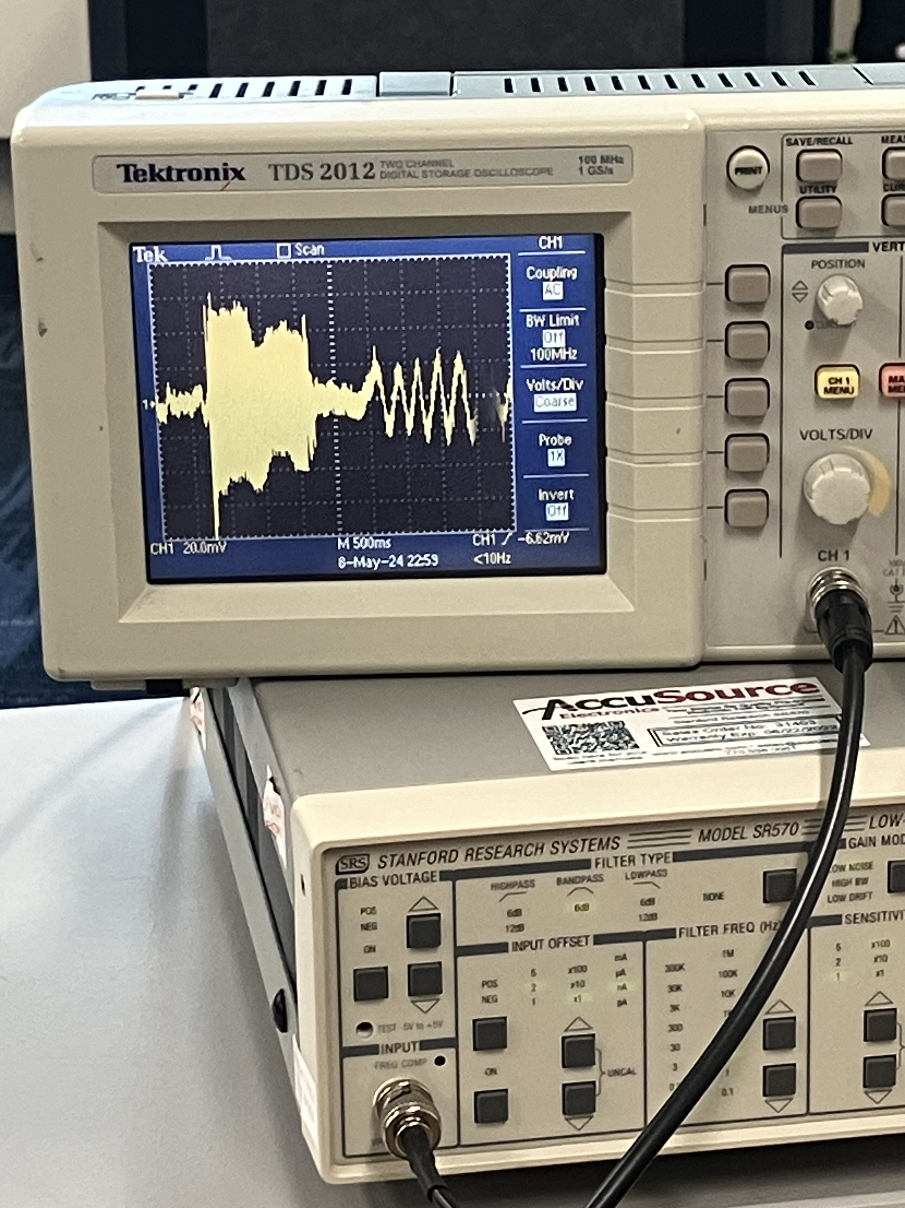
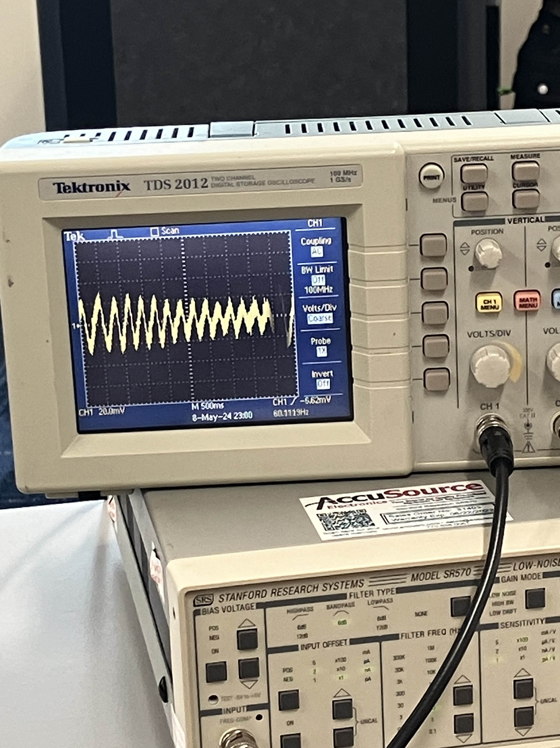
Oscilloscope Output

